Slide 1
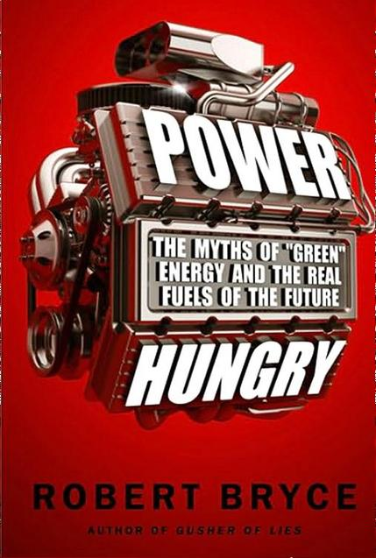
Chapter 30
Toward Cheap, Abundant Energy
Presentation by: Friend Olsen

Slide 2
"...over the long term, societies that expand and improve their energy supplies overwhelm those that don't. The paramount objective of US energy policy should be to promote abundant supplies of cheap energy and to facilitate their distribution and consumption.“
- Peter Huber and Mark Mills, Authors of The Bottomless Well
In November 2009, American unemployment hit 10.2%
Unemployment hovers at 7.7% in February 2013 (14.3% if underemployment is counted)
Bryce estimates 1 of every 6 Americans is below the poverty line,
1 in 5 children, 1 in 3 African-American children
Enron, Madoff, Kozlowski, The Iraq War… hideously expensive and highly public events erode concern for the environment over concern for survival
56% of Americans “say they are not willing to pay more in taxes and utility costs to generate cleaner energy and fight global warming.”
-Rasmussen Reports

Slide 3
“Cheap Energy Must Be the Priority.”
Cheap Energy will help humanity
adapt to changing climate
produce more potable water
enable better mobility
ensure greater productivity
“Americans must reject the notion that energy should be scarce and expensive.”

Slide 4
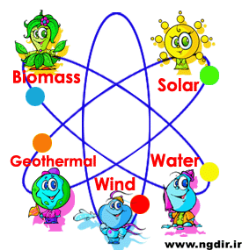
"We must understand… that facts are better than dreams."
"Natural gas and nuclear power offer the best no-regrets energy policy because they reduce the volumes of neurotoxins released into the environment, cut solid waste production, slash greenhouse gasses, eliminate air pollution, and obviate the need for carbon capture and sequestration."
"There is no silver bullet. We cannot rely solely on wind and solar power to fuel our economy. Nor can we solely focus on hydrocarbons and nuclear power. We will need all of those sources, because it is the nature of civilization to use energy. More energy means more power. And we are, all of us,
Power Hungry."

Slide 5
Questions?

