Slide 1
Chapter 28: Future Nukes
Tim Fountain

Slide 2
Energy Demands Are Growing
Demands grew by 9% annually in the 1950’s
Increases in economic efficiency led to decreased increases in energy demand per year
1.1% growth per year in mid 2000’s
Fell in 2008, 2009 but is expected to rise again
EIA estimates 14% increase in demand by 2030, a 30% increase from 2007

Slide 3
Nuclear Power: Option?
With growing energy demands, need more options for power
Push for cost effective AND green energy
Nuclear energy seen as great possibility

Slide 4
Nuclear Power
Proponents claim the following:
High energy density
No CO₂ emissions (green!)
Long lasting source of power
Critics claim the following:
Huge, cost ineffective reactors
Great danger of nuclear waste, weapon proliferation, accidents

Slide 5
Who is right?
Concerns are valid
Accidents (Chernobyl, Three Mile Island, Japan, etc.)
Nuclear waste
Weapon proliferation
Cost
BUT there is continual improvement in cost effectiveness and safety
Engineers must disprove negative perceptions to public
Highly trained professionals should be in charge of such operations
In over 5,400 reactor years US Navy has never had a reactor accident
First nuclear sub launched in 1954
New models being created to address issues
Modular Reactors
Pebble Bed Design
Thorium Fuel

Slide 6
Modular Reactors
Small reactors, many 125 MW or less
Many benefits to small reactors
More cost effective
Can use single or multiple units as needed
Centralized production
Underground construction safer, more secure

Slide 7
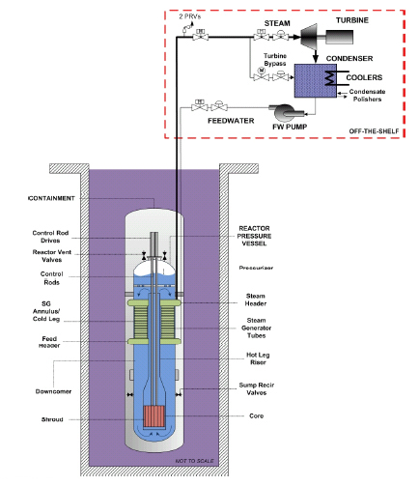
Modular Reactors
Figure 1: Schematic diagram of a modular reactor
http://www.nrc.gov/reactors/advanced/nuscale.html

Slide 8
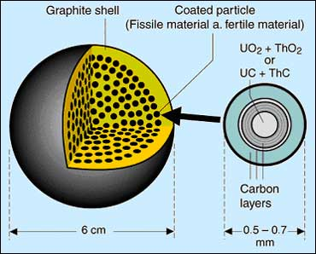
Pebble Bed Design
Safe design that virtually eliminates possibility of catastrophic meltdown
Nuclear material mixed in carbon “pebbles” that absorb neutrons and slow rate of fission
Cooled by inert gas, not water
Thick, temperature resistant buildings
Fuel cycle produces less plutonium
Figure 2: “Pebble” used as fuel in PBR’s
http://www.euronuclear.org/info/encyclopedia/p/pebble.htm

Slide 9
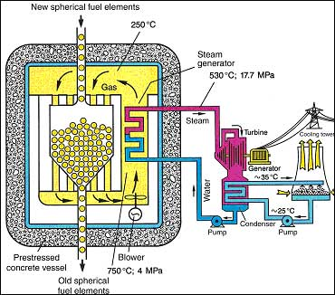
Pebble Bed Reactor
Figure 3: Schematic representation of PBR
http://www.euronuclear.org/info/encyclopedia/p/pebble.htm

Slide 10
Thorium Reactors
Do not produce plutonium
4x more abundant than Uranium
US holds approximately 20% of world supply
5-15% cheaper than Uranium
Can be re-enriched

Slide 11
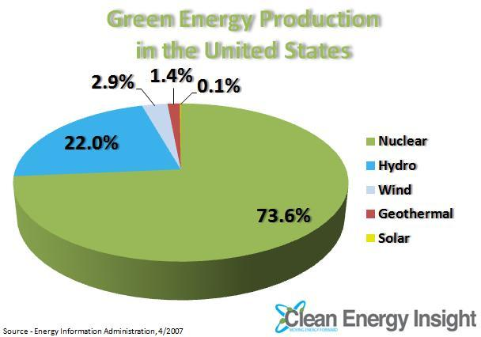
What’s the hold up?
Negative public perception
Regulations, regulations, regulations

Slide 12
Conclusion
Energy demands are growing, need more power
Nuclear power is one of the best, cleanest large scale energy production methods but concerns still exist
Concerns are being alleviated with new technologies and responsible handling
Reactors are becoming smaller, cheaper, and safer
Regulations make it difficult to obtain licenses for new plants and designs

Slide 13
Quiz Questions
Energy demand is expected to _________ in the coming years.
Answer - Increase
List two concerns associated with nuclear power that must be addressed.
Answer(s) – Meltdown/accident, fallout, cost, size, nuclear waste, etc.
What are three types of safer, more efficient nuclear reactors that are being researched for the future?
Answer - Modular Reactors, Pebble Bed Reactors, and Thorium Reactors

Slide 14
Questions? Comments?

