Slide 1
Why N2N? And Why Now?
The Megatrends Favoring
Natural Gas and Nuclear
Ch. 21 of Power Hungry
By Robert Byryce
Presented By James Tomich

Slide 2
N2N
“N2N means increasing our use of natural gas as we slowly transition to the use of more nuclear power over the next two to four decades.”-(Bryce, p. 208)

Slide 3
Outline
It has been happening already
Megatrends
Reserves Vs. Resources
Global Output “Peaks”

Slide 4
Global Primary Energy Use by Source - Millions Tones Oil Equivalent
133%
214%
239%
427%
143%
Source: BP Statistical Review or World Energy 2012

Slide 5
Megatrends
Increasing Urbanization of the Global Population
Decarbonization
Efforts to cut CO₂ emissions due to Climate Change
Increasing use and availability of gaseous fuels
Concerns about Peak Oil and Peak Coal

Slide 6
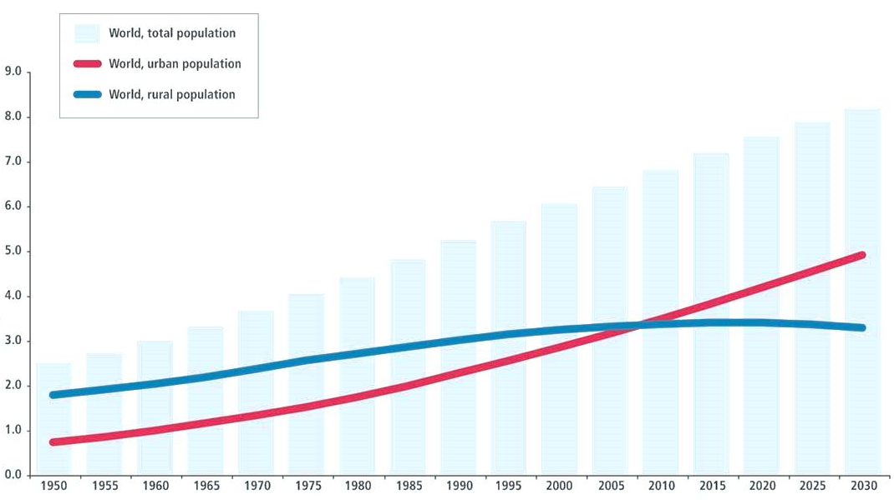
Increasing Urbanization of the Global Population
Population (Trillions of People)
Source: United Nations http://www.un.org/esa/population/publications/WUP2005/2005wup.htm

Slide 7
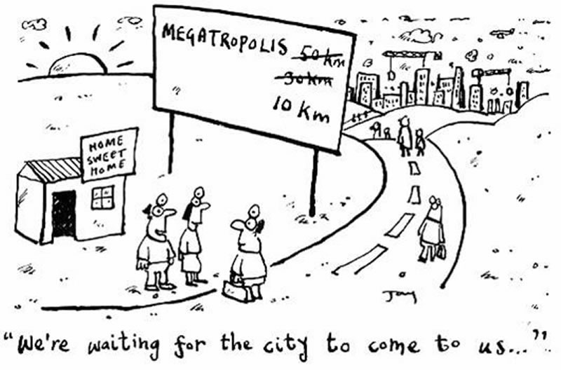
Increasing Urbanization of the Global Population
“…natural gas and nuclear are the obvious choices for providing the cooking and heating fuel the city-dwellers need as well as the electricity they need to turn on their lights and keep their computers, entertainment centers and appliances running.”-(Bryce, p. 224)
Source: http://www.geographypages.co.uk/a2ruralurban.htm

Slide 8
Decarbonization
“The ongoing global trend toward consumption of fuels that contain less carbon.”-(Bryce, p. 218)
Source: Lewis E. Gilbert -Greenhouse Gas Intensity and Business as Usual

Slide 9
Carbon-to-Burnable-Hydrogen Ratio
Fuel Source | Carbon-to-Burnable-Hydrogen Ratio C:H
Wood | 10:1
Coal | 2:1
Oil | 1:2
Natural Gas* | 1:4
Nuclear | No Carbon involved
* Assuming 100% Methane, CH₄

Slide 10
Carbon-to-Burnable-Hydrogen Ratio
All Natural Gas is not Equal
Sample 1
Sample 2
Source: Questar Natural Gas

Slide 11
Increasing use and availability of gaseous fuels
Reserve-“only applies to in-the-ground hydrocarbons that have been surveyed by drilling and other agreed-upon techniques”.
Resources- “is something that’s probably out there”.
Notes:
Ali al-Naimi, Saudi Arabia’s oil Minister announced on March 19th they will remain an “energy powerhouse” by tapping into its 600 trillion cubic ft unconventional

Slide 12
Increasing use and availability of gaseous fuels
US Production Gas from Shale
US Production Oil from Shale
Trillion Ft³ Per Day
Millions Barrels per Day
Year
Year
Source: EIA

Slide 13
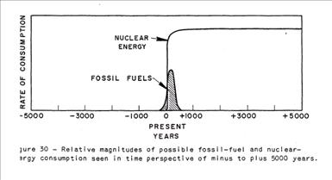
Peak oil
“The peaking of oil demand in the United States would be driven by an number of factors, including the economy, the age of the population and the efficiency of the automotive fleet.” _{(Bryce, p221)}
Source: M. King Hubbert's 1956 paper, Nuclear Energy and the Fossil Fuels

Slide 14
Peak oil

Slide 15
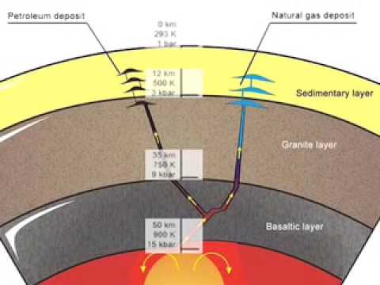
Peak oil?
Spanu L, Donadio D, Hohl D, Schwegler E, Galli G. Stability of hydrocarbons at deep Earth pressures and temperatures.Proceedings Of The National Academy Of Sciences Of The United States Of America. April 26, 2011;
Notes:
We report ab initio molecular dynamics simulations and free energy calculations aimed at investigating the formation of higher HCs from dissociation of pure methane, and in the presence of carbon surfaces and transition metals, for pressures of 2 to 30 GPa and temperatures of 800 to 4,000 K. We show that for T ⩾ 2,000 K and P ⩾ 4 GPa HCs higher than methane are energetically favored. Our results indicate that higher HCs become more stable between 1,000 and 2,000 K and P ⩾ 4 GPa.

Slide 16
References
Bryce, Robert. Power Hungry: the Myths of "green" Energy and the Real Fuels of the Future. New York, NY: PublicAffairs, 2010.
Cutler J. Cleveland (Lead Author);Cutler J. Cleveland (Topic Editor) "Nuclear Energy and the Fossil Fuels (historical)". In: Encyclopedia of Earth. Eds. Cutler J. Cleveland (Washington, D.C.: Environmental Information Coalition, National Council for Science and the Environment).
Lawrence Livermore National Laboratory-https://www.llnl.gov/news/newsreleases/2011/Apr/NR-11-04-04.html
Lewis E. Gilbert, Greenhouse Gas Intensity and Business as Usual-http://www.earthmc.com/Ideas/Bush/BushClimatePolicy.html
Questar Gas Analysis reports March 2013
BP Statistical Review or World Energy 2012
EIA.com
United Nations http://www.un.org/esa/population/publications/WUP2005/2005wup.htm
http://www.geographypages.co.uk/a2ruralurban.htm

Slide 17
Questions?
What is N2N?
What is the Carbon to Hydrogen ratio of Natural Gas?

Slide 18
Thank You

