Slide 1
Chapter 15
The US can cut CO₂ emissions but 80% by 2050, and Carbon Capture and Sequestration Can Help Achieve That Goal
-Presentation by Martha Krebsbach

Slide 2
Carbon Dioxide Emissions
In 2009, President Obama promised to reduce carbon dioxide emissions by 80% by 2050
Suggestions have included
Transitioning to carbon-free energy
Shutting down coal plants
Where does the replacement energy come from?
Would have to replace 200 barrels of oil each day
Too many people living in energy ‘poverty’ to viably replace

Slide 3
Under the target set by Obama
United States would have to produce less carbon dioxide now than China per capita, around 4.27 tons of CO₂ a year
There is no cheap, viable alternative methods of producing that much clean energy

Slide 4
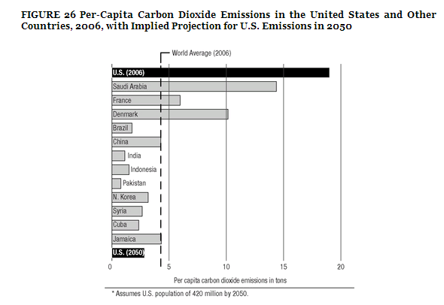

Slide 5
Carbon Capture and Sequestration
“Holy Grail” of carbon strategies
Capture CO2 from the flue of coal plants
Condense it and inject it into geological formations
However, it is not economically viable
Only shown to work on small scale projects, not the large ones we need
Introduces a parasitic load of 28% on power plants, energy that is not sold to the customer

Slide 6
Questions
What is the percent of parasitic load that would be placed on a power plant operating Carbon Capture and Sequestration?
28%
The nation’s goals of reaching an 80% reduction in CO2 emissions is unrealistic for what main reason?
No cheap alternative to produce energy

