Slide 1
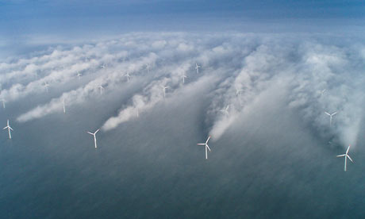
Power Hungry Chapter 9 Myth: Wind Power Reduces CO₂ Emissions
Presented by: Stephen Berwick

Slide 2
Facts
There is not a single study based on actual data from existing wind turbines that can prove that wind power reduces CO₂ emissions
All turbines require back up dispatchable hydrocarbon electric generation capacity
More expensive because of non-sustainable power and need for back up generators.
Capacity factor =amount of time producing 100% max output
For wind turbines Capacity is typically 10-20% of max rated value

Slide 3
Examples outside of USA
China wants to build new “Green Cities” powered by wind farms, but to accomplish this, dozens of new coal-fired power plants will be needed to meet the power demands.
Denmark uses hydropower back up generators but has seen no reduction in CO₂ emissions

Slide 4
Example Texas
Top wind generating state in the US
2008 Texas installed 2,700mega watts of wind turbines in 2009 and it was determined that the turbines had a capacity factor of 8.7%
In mid-2009 there were 8,203MW of wind power with an estimated 708MW of it considered reliable.
In summer Texas needs 72,648 MW and wind only accounts for 1% of the total energy needed, the rest in gas fired back up generators.

Slide 5
Generation capacity in Texas 2009,2014
*Horizontal axis in Megawatts

Slide 6
CERA Findings
CERA 2008 report
“it is more expensive than conventional power generation in part because wind’s intermittent production patterns need to be augmented with dispatchable generators to match power demand.”
“ In order to provide reliable capacity throughout the year, every megawatt of wind capacity need to be matched up with a megawatt of dispatchable capacity.”

Slide 7
Conclusion
Global Wind Energy Council claims that by 2030 global wind-power capacity will have a five-fold increase over 2007, generating 500,000 MW, which the group expects would cut CO2 emissions by 731M tons
1MW= 3.5*10^6 BTU Natural Gas=409 Lbs of CO₂
500,000MW wind energy *0.20 = 100,000MW
500,000MW * 409= 102,205 Tons of CO₂

Slide 8
Questions
Q. What is the capacity factor of wind power.
A. 10-20%
Q. What is the actual percent of wind power used in Texas.
A. 1%
Q. What picks up the slack when there is no wind.
A. hydrocarbon back up generators.

