Slide 1
Chapter 6: If Oil Didn’t Exist, We’d Have to Invent it
Reviewed by: Shawn McCarther

Slide 2
Quote from Chapter
“Without transportation, there is no commerce.”—Don Cheatham
Bryce’s Hypothesis:
Without oil, there is no commerce.

Slide 3
Pros and Cons
Pros:
“Oil shrunk the world.”
“Oil makes us rich.”
Cons:
Frequent wars in the Middle East over oil flow
Carbon dioxide induced into atmosphere

Slide 4
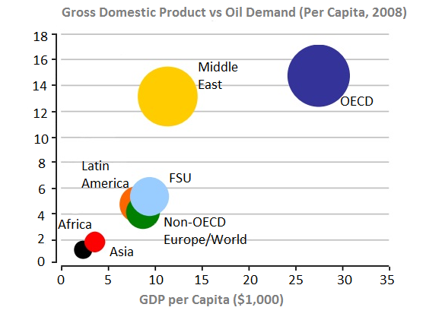
Oil Produces Economic Growth
Oil Demand per Capita (barrels)
*OECD – Organization for Economic Cooperation and Development
In countries where oil demand is more than twelve barrels per capita, GDP is at least two
times as high as countries that demand less than six barrels of oil per capita.

Slide 5
Any Questions?
What natural resource can readily replace oil?
No quick replacements
Why does Bryce relate oil and commerce?
Commerce requires transportation, which requires oil.

