Slide 1
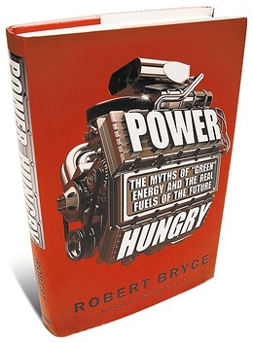
Chapter 8 Wind and Solar Are “Green” ----MYTH----
Density is Green
Small is Beautiful
Lots of Power From Small Pieces of Real Estate
Presented by: Darren Scott

Slide 2
We want:
Type:
Lots of Power
From:
Small Pieces
Impacting:
Small Real Estates
“We want small pieces of real estate to provide small pieces of high power output energy.”

Slide 3
Main Thoughts → Energy Sprawl / Energy Efficiency:
Example:
South Texas Nuclear Project based on 12,000 Acres & 2,700 Megawatts
300 HP/Acre --- Nuclear Power ---- 12,000 Acres --- 18.75 Sq-Miles
287 HP/Acre --- Natural Gas ----12,544 Acres --- 19.6 Sq-Miles
148.5 HP/Acre --- Oil Stripper Well ---- 24,960 Acres --- 29 Sq-Miles
36 HP/Acre --- Solar Power ---- 99,840 Acres --- 156 Sq-Miles
6.4 HP/Acre --- Wind Power ---- 556,160 Acres --- 869 Sq-Miles
2.1 HP/Acre --- Biomass Fuel ---- 1,667,840 Acres --- 2,606 Sq-Miles
0.25 HP/Acre --- Corn Ethanol ----- 13,610,880 Acres --- 21,267 Sq-Miles
“The power lines needed to connect future wind power alone would cover the state of Rhode Island, or approximately 40,000 miles line would need 750 Sq-Miles.”
Bryce, Robert. Power Hungry: THE MYTHS OF “GREEN” ENERGY AND THE REAL FUELS OF THE FUTURE. New York: PublicAffiairs: 2010.

Slide 4
Conclusion’s:
If we are going to go “Green” we have to understand the facts about the supposedly “Green” impacts of alternative energy sources. We must understand size versus power as well as alternatives and their impacts.
Solar/Wind/Bio-fuel/Corn-Ethanol are not “Green.” They have low power density and have a negative impact on “Green” desires!

